Slide 1
WEBI
Milind Parab

Slide 2
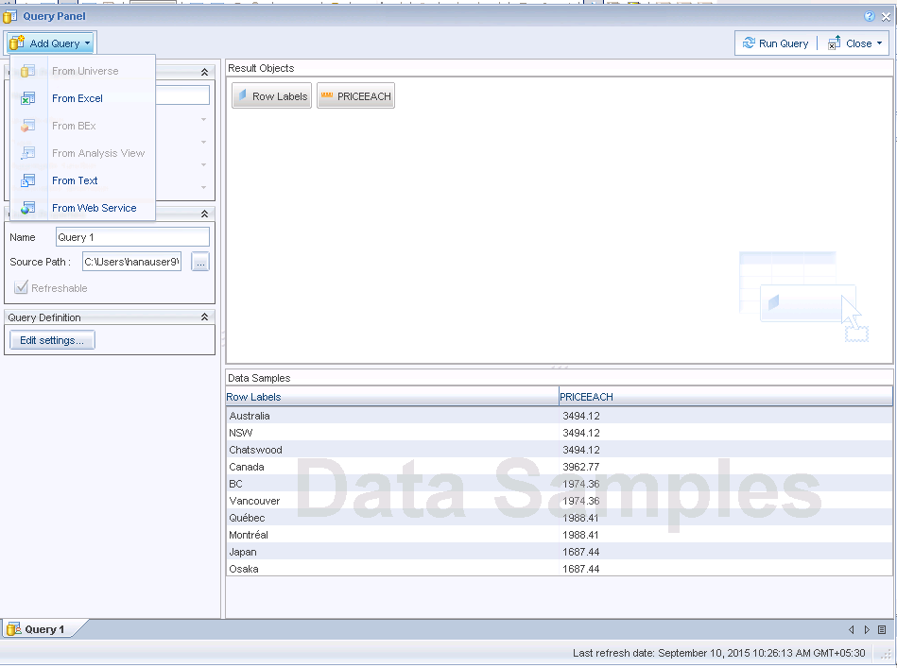
Data Import options.

Slide 3
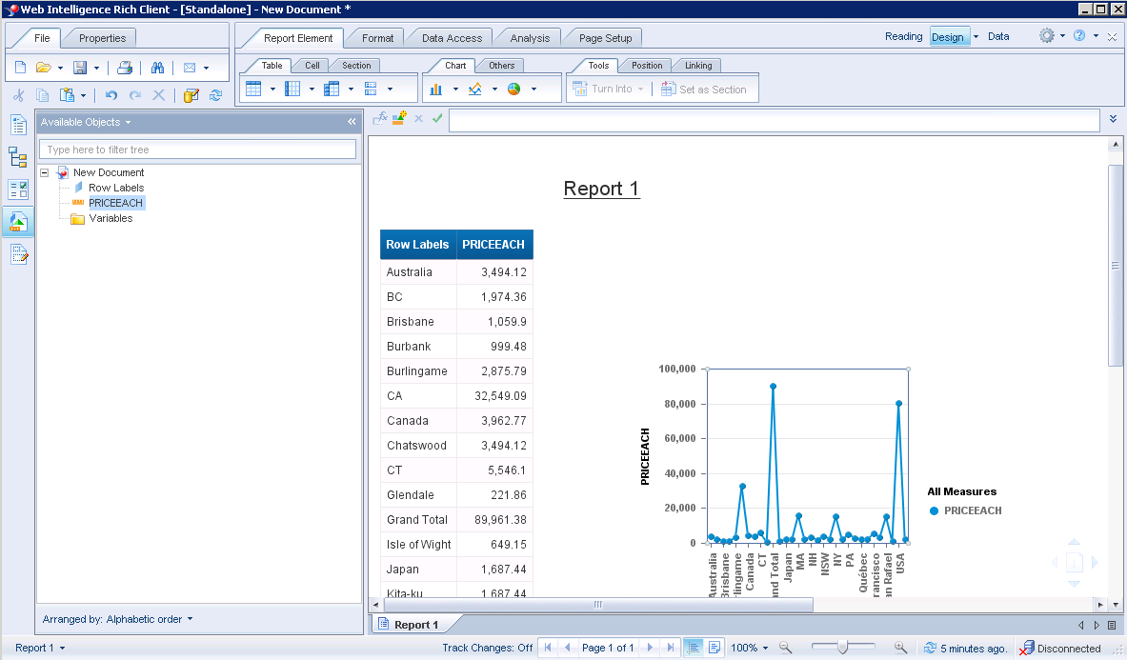
Report Sample in WEBI.

Slide 4
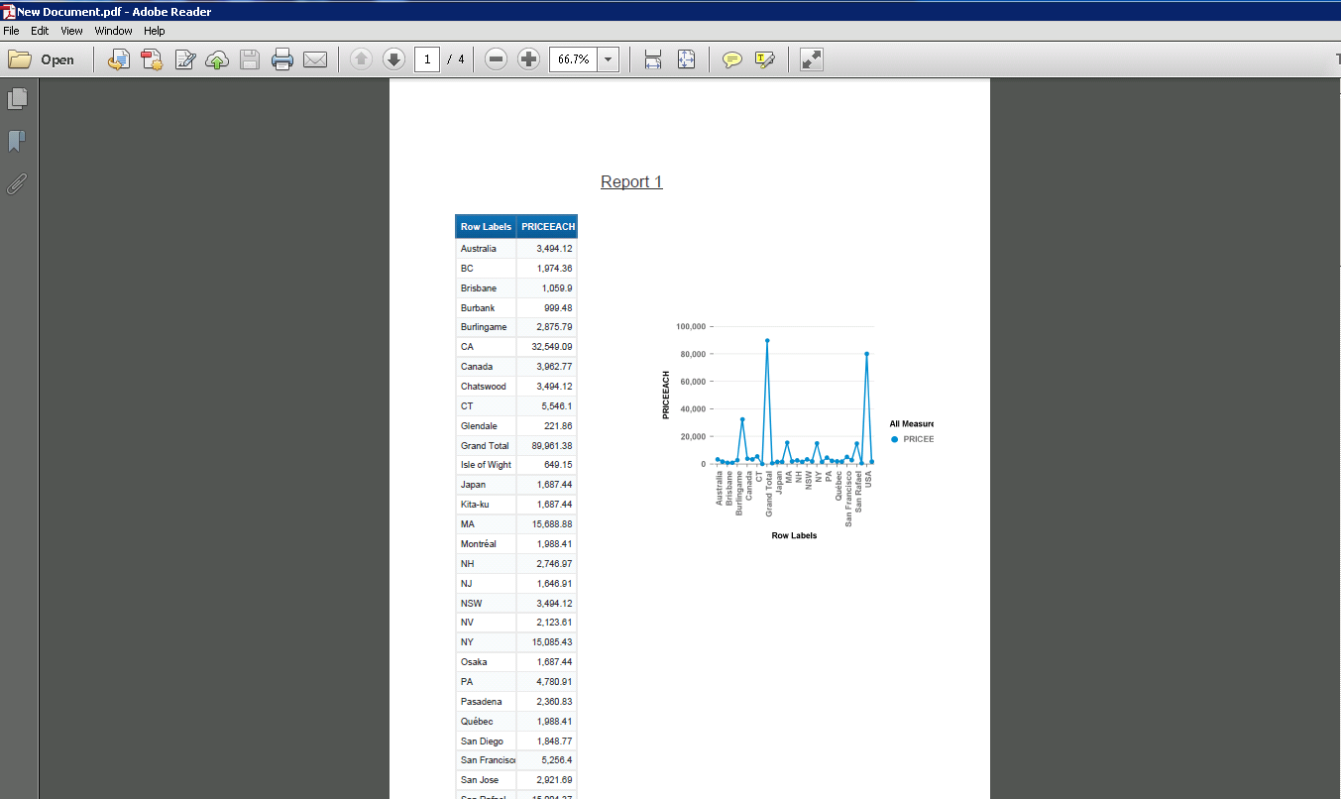
Report can be converted in .pdf

